Slide 1
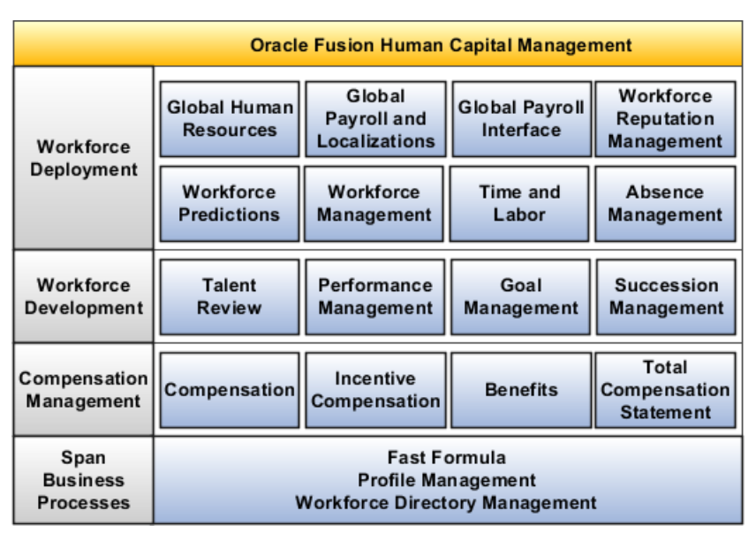
Oracle HCM Cloud: Overview

Slide 2

Oracle BI Publisher(BIP)

Slide 3

Introduction
Introduction

Slide 4
BI Publisher
Overview
Oracle BI Publisher is a strategic enterprise reporting product from Oracle
Ability to create and manage highly formatted reports from a wide range of data sources
It is available as part of the Oracle BI Enterprise Edition Suite and also as a stand alone reporting tool
Report formats can be designed using Microsoft Word, the tools that are easy to use, and most users are already familiar with

Slide 5
BI Publisher
Features
  It has separate Query (Retrieve data from data base)
  Layout (Layout based on the business Requirement)
  Create custom data models based on any query
  Supports different output formats like .rtf, .csv, .pdf, .xls etc.
  Supports scheduling
  Supports bursting (process of generating multiple documents)

Slide 6
Getting Started
Getting started

Slide 7
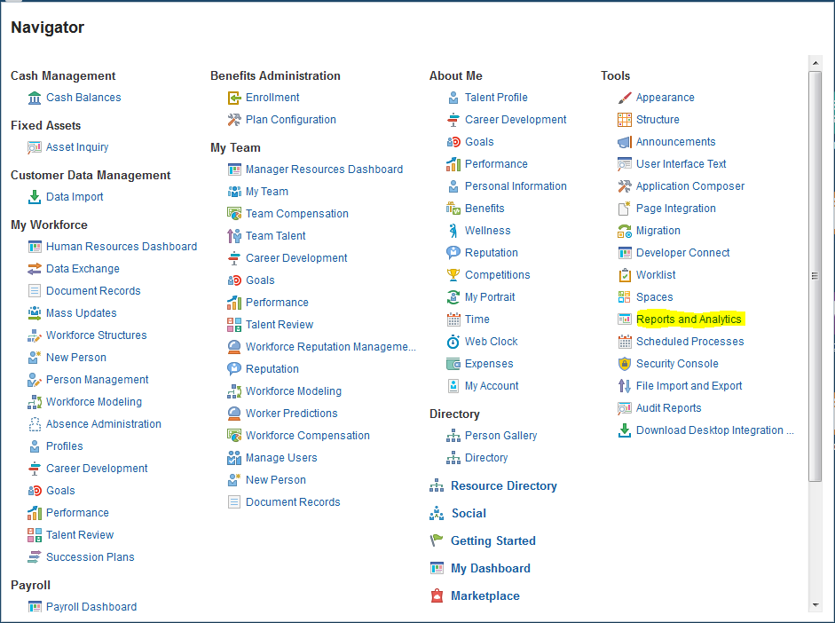
BI Publisher
  Navigation: For accessing the Analytics page
  Login to Fusion Application → Navigator → Tools → Reports and Analytics Link

Slide 8
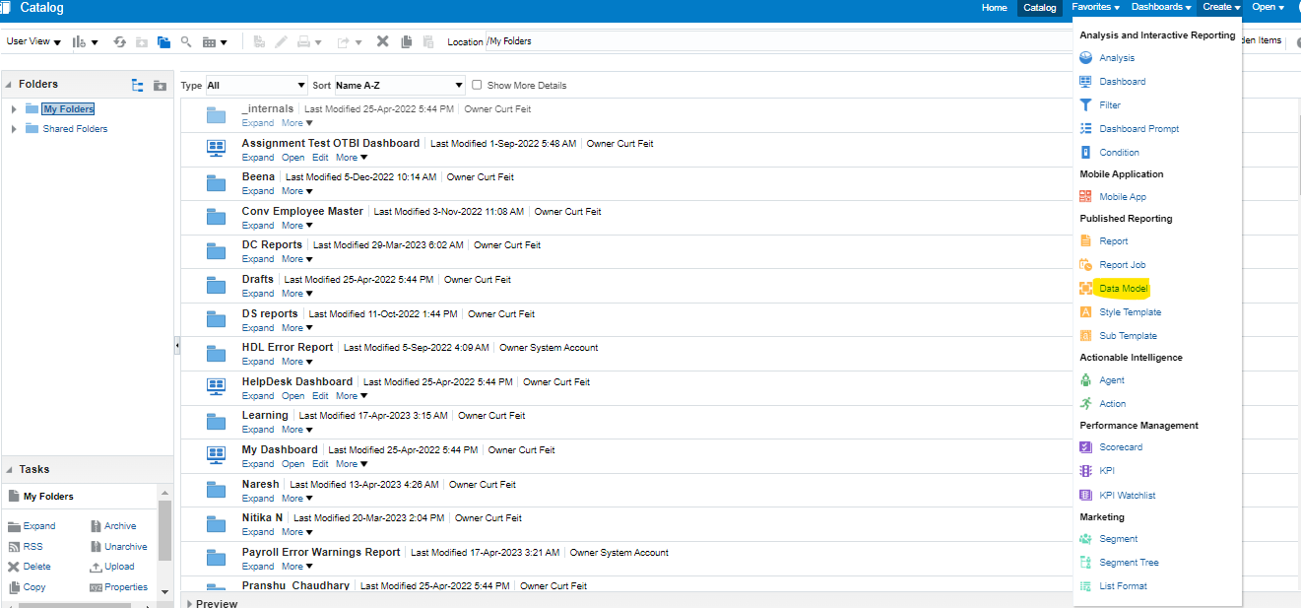
BI Publisher
Data Model

Slide 9
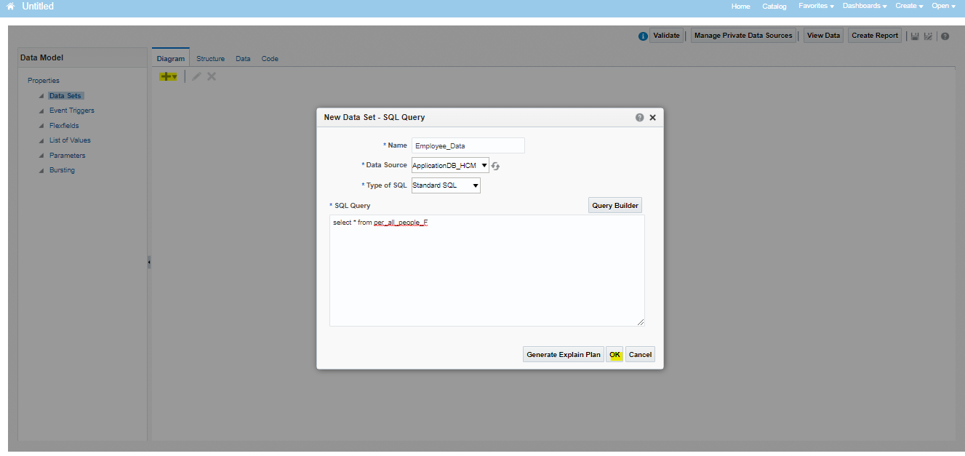
Data Model

Slide 10
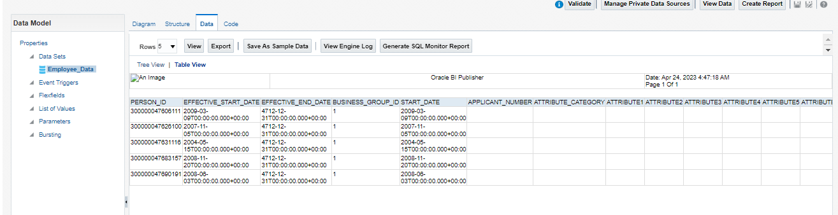
Data Model

Slide 11
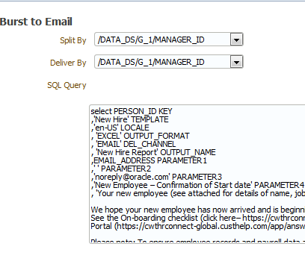
Adding Bursting to data model
Split By - An element from the data that will govern how the data is split
Deliver By - The element from the data that will govern how formatting and delivery options are applied
SQL Query - A SQL query that you define for BI Publisher to construct the delivery XML data file,
The query must return the formatting and delivery details
Note - The structure of the delivery XML required by BI Publisher is specific to delivery output such as Email etc.

Slide 12
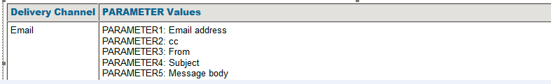
Creating BIP Reports
Adding Bursting to data model

Slide 13
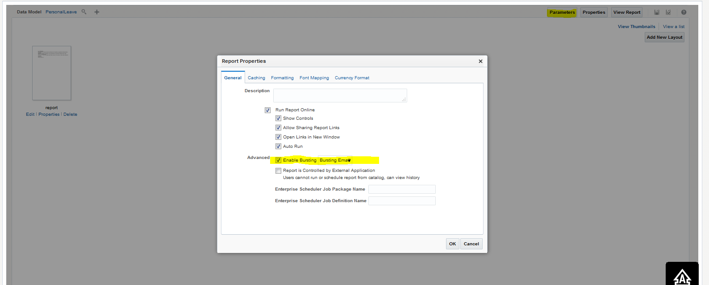
Creating BIP Reports
Bursting Setting

Slide 14
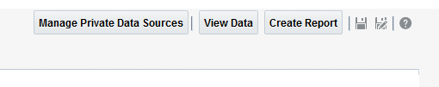
Creating BIP Reports
Save data model
To make the data model accessible to other user, save it under “Shared folder”

Slide 15
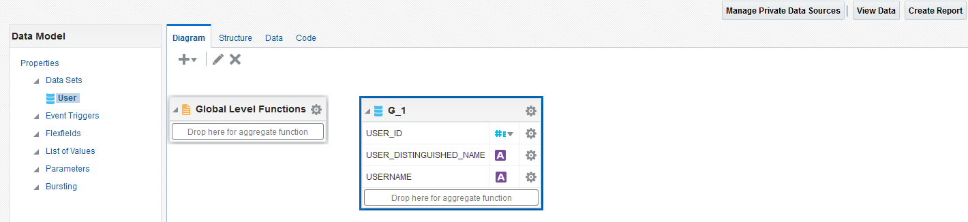
Creating BIP Reports
Create Report Template
On the top right corner of the Data Model Editor, click on the Create Report icon, This is used to create reports using Guided Layout Builder

Slide 16
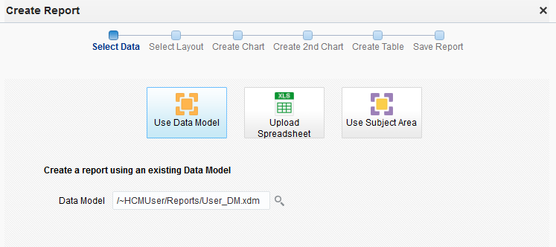
Creating BIP Reports
Create Report Template

Slide 17
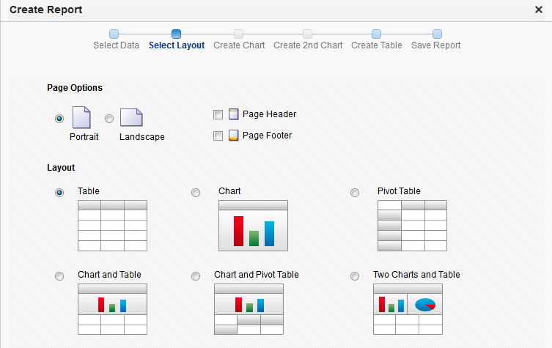
Creating BIP Reports
Create Report Template

Slide 18
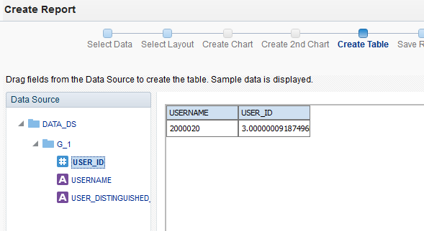
Creating BIP Reports
Create Report Template

Slide 19
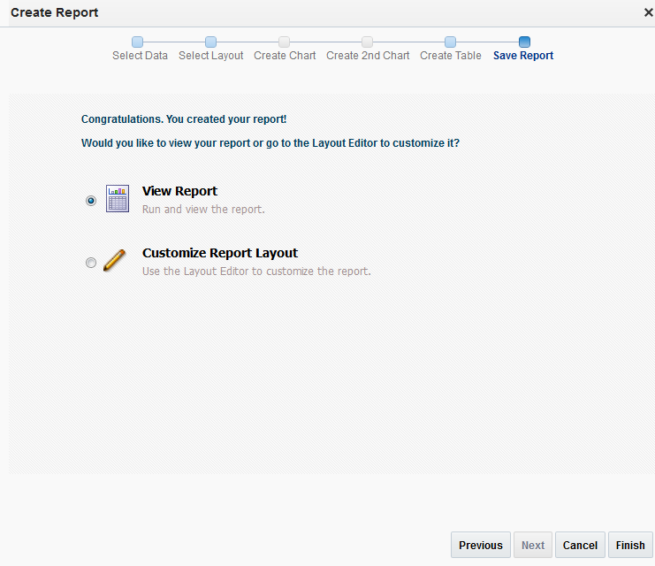
Creating BIP Reports
Create Report Template

Slide 20
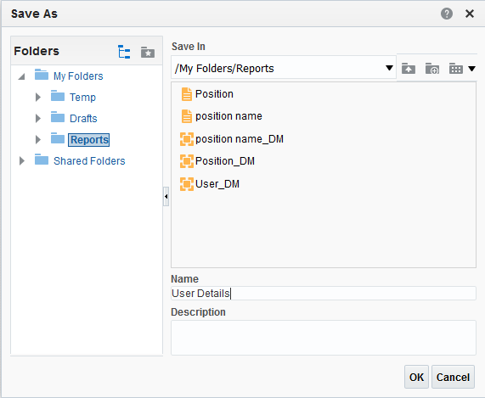
Creating BIP Reports
Create Report Template

Slide 21
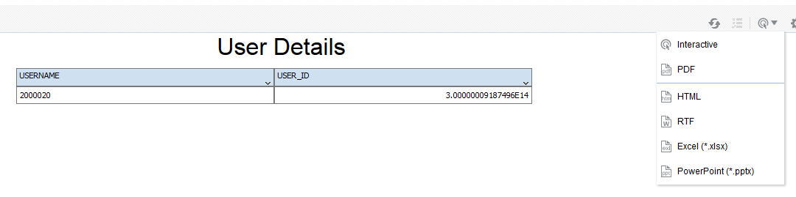
Creating BIP Reports
View the output

Slide 22
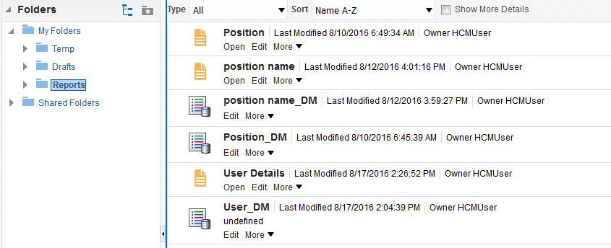
Creating BIP Reports
Accessing the saved reports
Navigate to the folder where you have saved the report
Open – To view the results of the reports
Edit – To edit the report layout

Slide 23
Reporting Templates
Reporting templates

Slide 24
Layout Types
BI Publisher offers several options for designing layouts for reports. The following formats are supported. The layout type determines the types of output documents supported.
Rich Text Format (RTF) | BI Publisher provides a plug-in utility for Microsoft Word that automates layout design from a Microsoft Word session. RTF templates support a variety of output types including: Excel (mhtml), Excel (html), Excel (*.xlsx), HTML, MHTML, PDF, PowerPoint, RTF, and Zipped PDF
Portable Document Format (PDF) | PDF templates are used primarily when you must use a predefined form as a layout for a report. PDF templates support only PDF output.
Microsoft Excel (XLS) | Excel templates enable you to map data and define calculations and formatting logic in an Excel workbook.
XSL Stylesheet | Layouts can also be defined directly in XSL formatting language. Specify whether the layout is for Data (CSV), Data (XML), FO Formatted XML, HTML, Text, or XML transformation.
eText | These are specialized RTF templates used for creating text output for Electronic Data Interchange (EDI) or Electronic Funds Transfer (EFT) transactions.

Slide 25
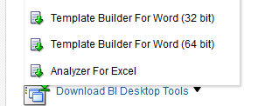
BI Template Builder
The Template Builder is an add-in to Microsoft Word and Excel that simplifies the development of templates
To download and install template builder, navigate to analytics home page. On left hand menu, select “Download BI Desktop Tool”

Slide 26
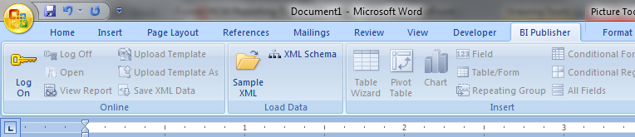
BI Template Builder
Post installation, a new menu will appear in Microsoft Word and Excel

Slide 27
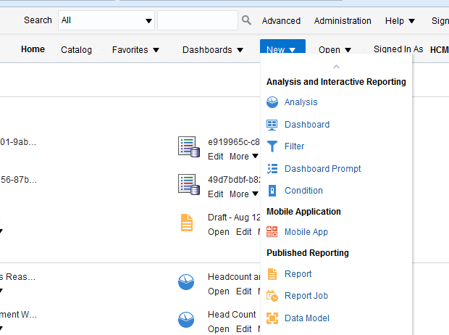
Create Report
Navigate to BI home page. Under New , select Report

Slide 28
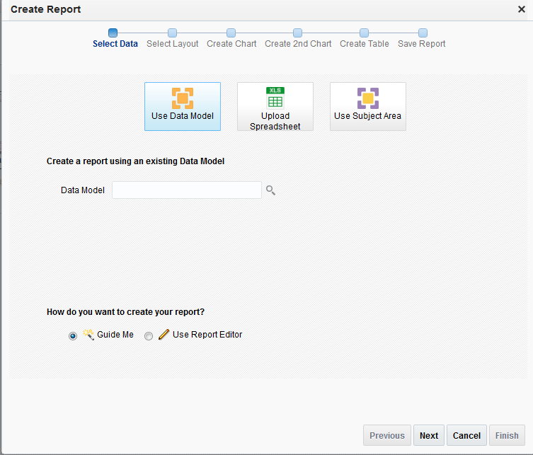
Create Report
Click Cancel on screen which opens

Slide 29
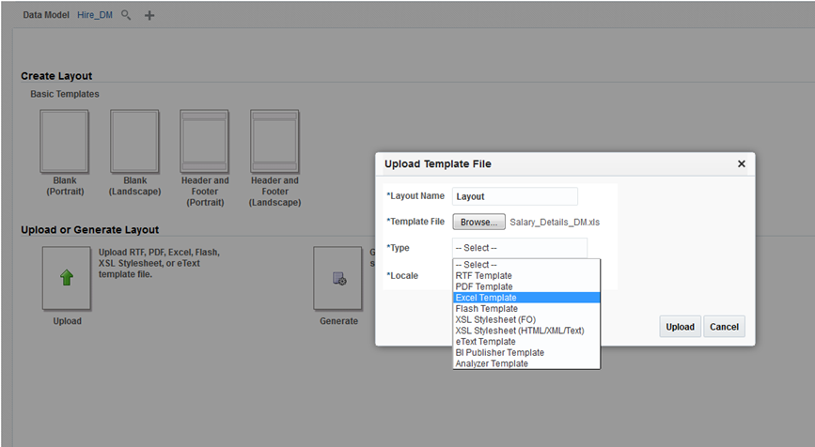
Create Report
Select the data model on which you want to create the report
Click on Upload button to upload the template

Slide 30
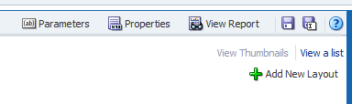
Create Report
After layout upload, save the report
Click ‘View Report’ on right hand side to view the output
Based on the layout and the supported output format, the results will be displayed

Slide 31
Scheduling
Scheduling

Slide 32
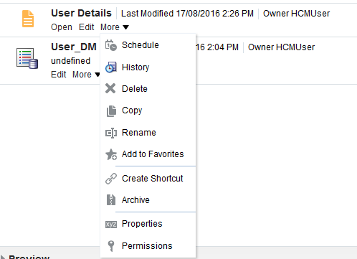
Schedule a BI Report
To run a BI report to run automatically, report can be scheduled

Slide 33
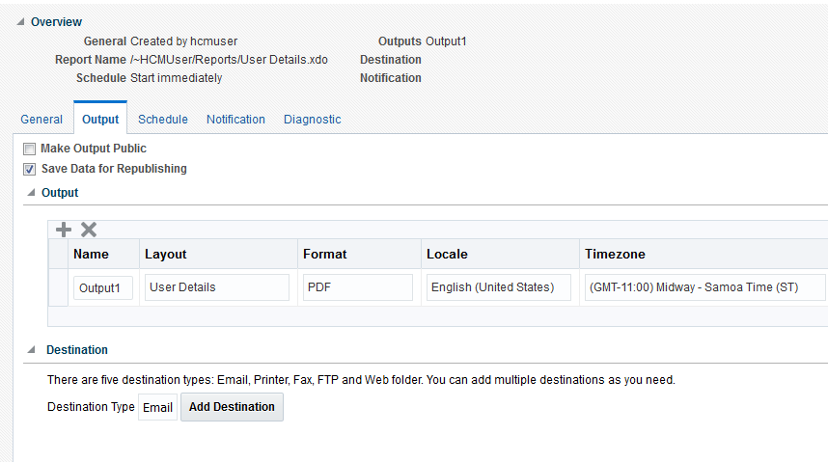
Schedule a BI Report
On the schedule page, select the tab “Output”
Define the destination as Email or FTP

Slide 34
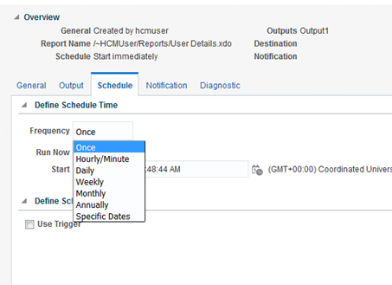
Schedule a BI Report
On the schedule page, select the tab “Schedule”
Define the frequency and start and end date

Slide 35
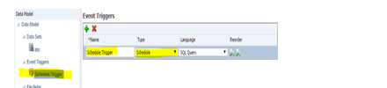
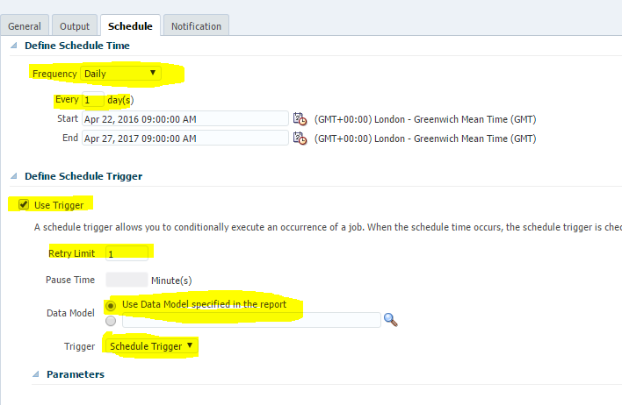
Schedule a BI Report
Combination of Schedule and Trigger

Slide 36
Documentation
Information about Oracle HCM Docs
https://www.oracle.com/in/human-capital-management/#rc30p1
Record Details
http://www.oracle.com/webfolder/technetwork/docs/HTML/oer-redirect.html

Slide 37


